Slide 1
F# Type Providers Compile-time meta-programming for the information-rich world Part 1 - Overview
Don Syme, Microsoft Research, F# Community Contributor, @dsyme

Slide 2
Part 1 – Overview, Examples, Motivation Part II – A closer look at implementing a type provider

Slide 3
Generic Programming? Not really Theorems? No Strongly Typed? Discuss

Slide 4
Proposition 1 The world is information-rich

Slide 5
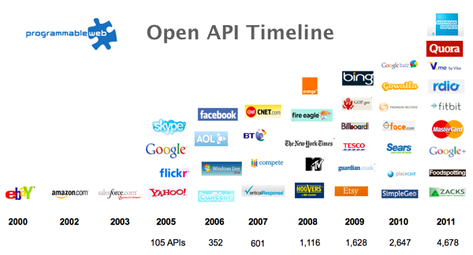
The Information Revolution

Slide 6
Proposition 2 Modern programming is intensely information-rich

Slide 7
Proposition 3 Our languages are information-sparse

Slide 8
Proposition 4 This is a problem (especially for strongly-typed languages)

Slide 9
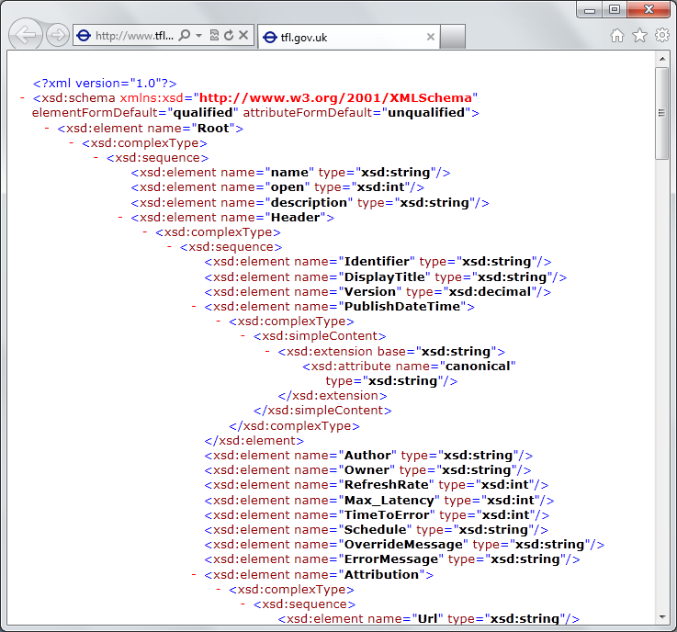
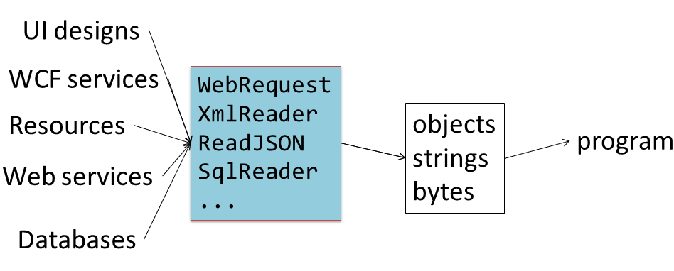
The developer’s perspective
Languages do not integrate information
Non-intuitive
Not simple
Disorganised
Static
High friction

Slide 10
We need to bring information into the language… At internet-scale, strongly tooled, strongly typed

Slide 11
Paradigm Locator
Statically Typed
Dynamically Typed

Slide 12
Paradigm Locator
Statically Typed
Dynamically Typed
A major search is on!
make statically typed langs more dynamic
make dynamically typed langs more static
apply modertated static typing much more broadly

Slide 13
A bit about F#...

Slide 14
F# is Open Source F# is Cross Platform
fsharp.org
fsharp.org/use/mac
fsharp.org/use/linux
fsharp.org/use/android
fsharp.org/use/ios
fsharp.org/use/gpu
fsharp.org/use/windows
fsharp.org/use/freebsd

Slide 15
F# 4.0 ✔ True shift to cross-platform open engineering ✔ Long laundry list of language items ✔ Normalized core library ✔ Type providers more powerful ✔ Better debugging, tooling, performance ✔ ~20% compiler perf improvement ✔ much more …

Slide 16
The F# Compiler – 300+ Pull Requests and rising Where to Contribute? See fsharp.github.io

Slide 17
The F# Language Design Process fslang.uservoice.com

Slide 18
Learn more
fsharp.org

Slide 19
F# and objects

Slide 20
Embrace objects, make them fit with the expression-oriented typed functional paradigm especially for interop and software engineering purposes but not embrace full “object-orientation”

Slide 21
F# - Objects + Functional
type Vector2D (dx:double, dy:double) =
let d2 = dx*dx+dy*dy
member v.DX = dx
member v.DY = dy
member v.Length = sqrt d2
member v.Scale(k) = Vector2D (dx*k, dy*k)
Inputs to object
construction
Object internals
Exported properties
Exported method

Slide 22
Objects
Constructed Class Types
type ObjectType(args) =
let internalValue = expr
let internalFunction args = expr
let mutable internalState = expr
member x.Prop1 = expr
member x.Meth2 args = expr
Object Interface Types
type IObject =
interface ISimpleObject
abstract Prop1 : type
abstract Meth2 : type -> type
Object Expressions
{ new IObject with
member x.Prop1 = expr
member x.Meth1 args = expr }
{ new Object() with
member x.Prop1 = expr
interface IObject with
member x.Meth1 args = expr
interface IWidget with
member x.Meth1 args = expr }

Slide 23
Functional
 | Expression-oriented | No null | Multiple Args = Tuples | Closure and Capture | First-class Values | Currying | HM Type Inference
void (unit) | ✓ | ✓ | ✓ | ✓ | ✓ | ✓ | ✓
Object Types | ✓ | ✓ | ✓ | ✓ | ✓ | ✓ | ✓
Subtyping | ✓ | ✓ | ✓ | ✓ | ✓ | ✓ | ¾
Dot-notation | ✓ | ✓ | ✓ | ✓ | ✓ | ✓ | ¾
Inheritance | ✓ | ✓ | ✓ | ✓ | ✓ | ✓ | ¾
Method Overloding | ✓ | ✓ | ✓ | ✓ | ¾ | ✗ | ¾
Objects
Relatively Graceful Degradation
(some type annotations needed)
Relatively Graceful Degradation
(some type annotations needed)
Some combinations outlawed for sanity

Slide 24
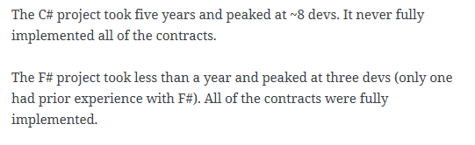
An analysis (Simon Cousins, Energy Sector)
350,000
lines of C# OO
by offshore team
30,000
lines of robust F#, with
parallel +more features
An application to evaluate the revenue due from Balancing Services contracts in the UK energy industry
http://simontcousins.azurewebsites.net/does-the-language-you-use-make-a-difference-revisited/

Slide 25
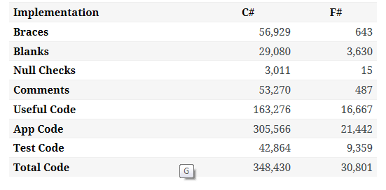

Slide 26
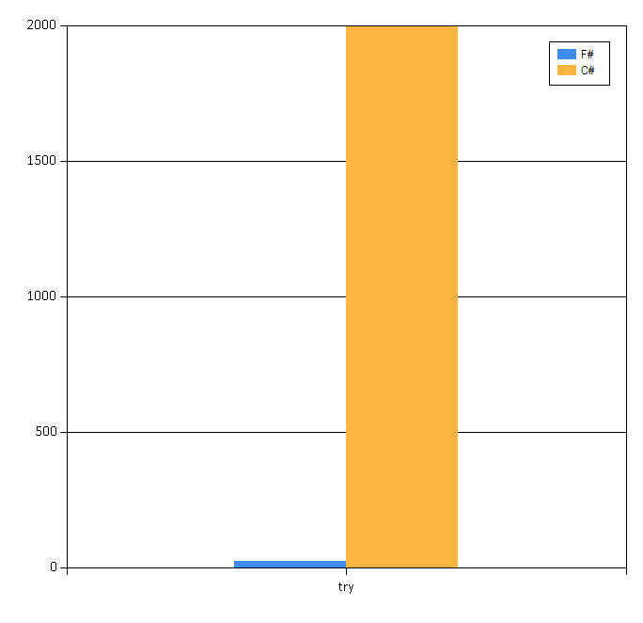

Slide 27
LIKE:
Instance notation and Type-directed name resolution x.P
Implicit constructors T(x,y)
Static members C.M
Named/optional arguments
Non-hierarchical interface types and implementations
USE WITH TASTE (1)
Mutable data
Defining events
Defining operators on types
Auto properties
Implementing IDisposable
Type extensions
Structs (for performance)
Delegates (for interop)
Enums (for interop)
OFTEN JUMPING THE SHARK
Nulls
Method overloading
Additional primary constructors
NOT EVEN SUPPORTED:
Curried overloaded members
Protected members
Aspect oriented programming
Implementation inheritance
OK BUT RARER:
Indexer, slicing notation arr.[x]
Unchecked.defaultof<_>
Implementing IEnumerable
USE WITH TASTE (2)

Slide 28
Back to the main topic…

Slide 29
We need to bring information into the language… At internet-scale, strongly tooled, strongly typed

Slide 30
Demo: F# to WorldBank

Slide 31
Walkthrough: JSON, XML, HTML Tables

Slide 32
A Type Provider is…. “Just like a library” “A design-time component that computes a space of types and methods on-demand…” “An adaptor between data/services and the .NET type system…” “On-demand, scalable compile-time provision of type/module definitions…”

Slide 33
Theme #1 On-Demand Type Environment = Internet Scalable

Slide 34
On-Demand Type Provision
let data = Freebase.GetDataContext()
1. Compiler/IDE requests metadata for symbol GetDataContext
Provider reports return type of FreebaseDataContext
data.
2. Compiler/IDE requests contents of type FreebaseDataContext
Provider asks Freebase metadata service for top-level domains
Provider reports top-level domains of Freebase as properties of the type
data.Society
3. Compiler/IDE requests metadata for symbol Society
...

Slide 35
Theme #2 Many Data Sources, One Mechanism

Slide 36
Note: Language still contains no data Open architecture You can write your own type provider

Slide 37
A different kind of meta-programming Lazy, on-demand generation of nominal object type definitions by compiler plugins Very limited parameters and computation in the language Plugins, not macros

Slide 38
http://fsharp.github.io/FSharp.Data/images/csv.gif http://fsharp.github.io/FSharp.Data/images/wb.gif

Slide 39
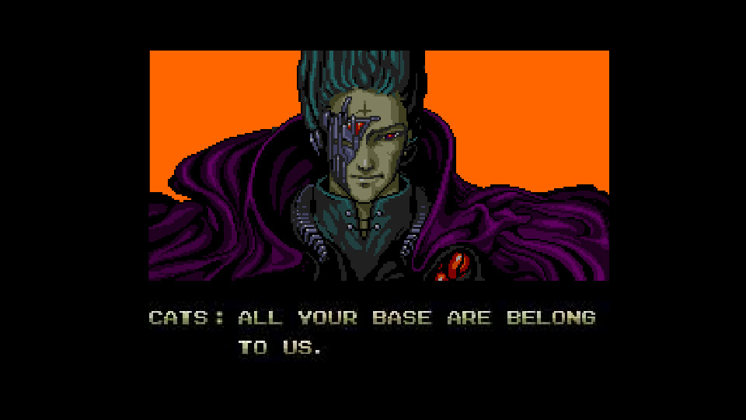
All your types are belong to us….
types

Slide 40
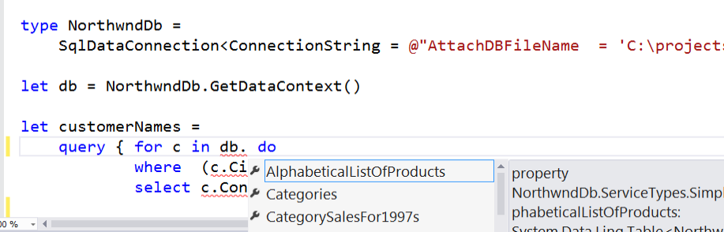
SQL #1

Slide 41
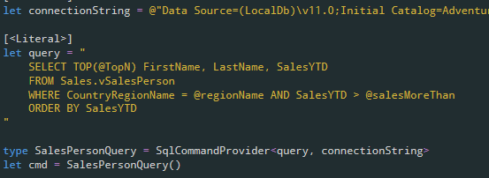
SQL #2

Slide 42
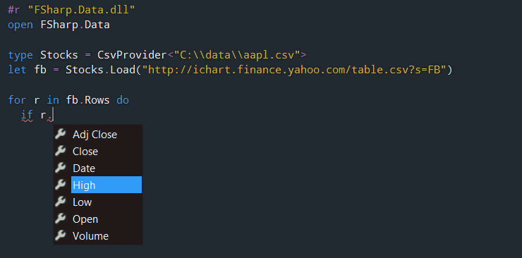
CSV

Slide 43
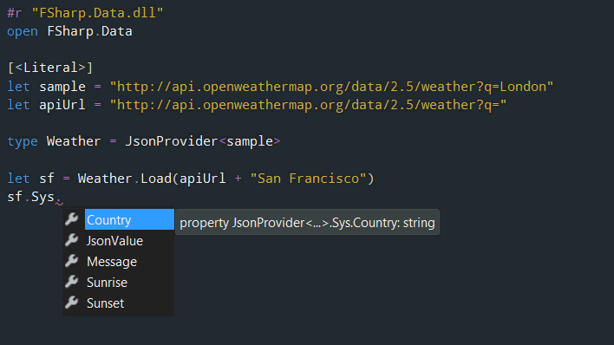
JSON

Slide 44
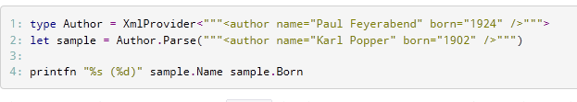
XML

Slide 45
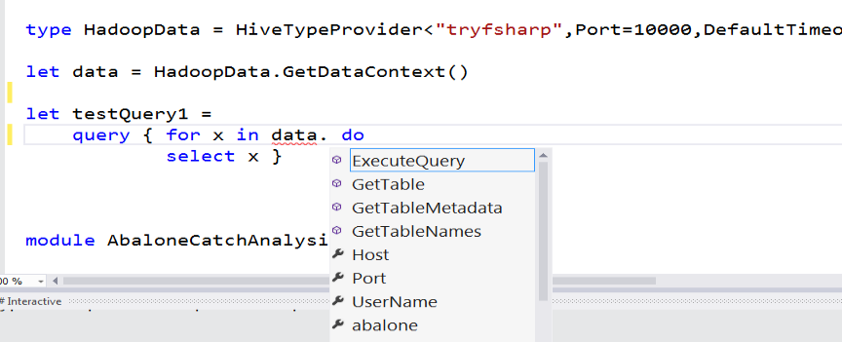
Hadoop/Hive

Slide 46
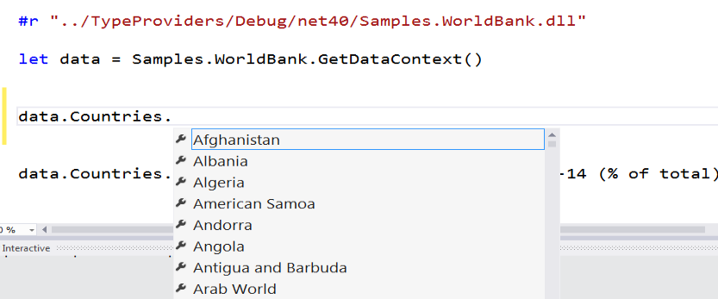
Web APIs

Slide 47
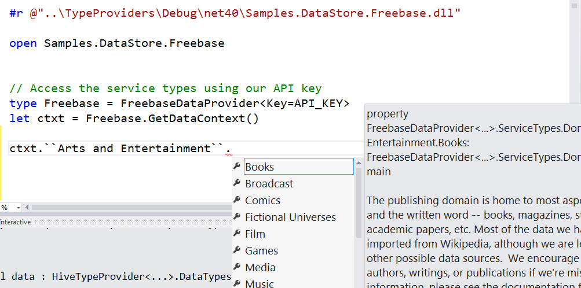
Entity Graphs

Slide 48
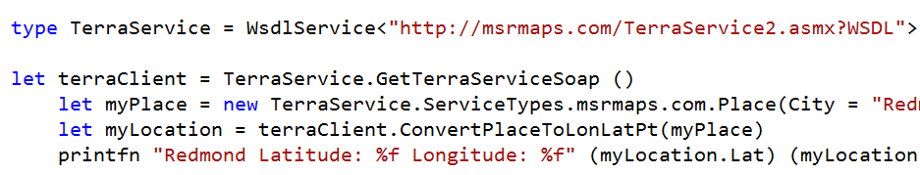
WSDL

Slide 49
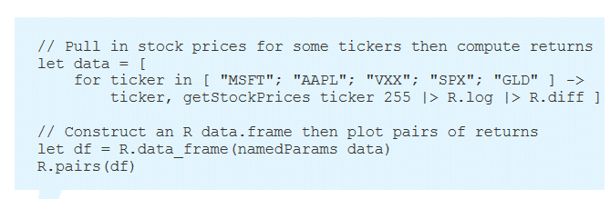
R

Slide 50
FSharp.Data on GitHub

Slide 51
Theme #3 Data and Types at Multiple Scales

Slide 52
Data at Multiple Scales
From Everything to Individuals
Data Scripters need to work with different granularities of schematization
data.AllEntites
data.Automotive.``Automobile Models``
data.Automotive.``Automobile Models``.Individuals.``Porsche 911``
…Only a language that supports massively scalable metadata can operate at all these levels
Every stable entity can get a unique type

Slide 53
Theme #4 Programming Type Systems v. Information Space Metadata Synergy or Conflict? Examples: Types, Schema, Constraints, Units of Measure, Security Information, Documentation, Definition Locations, Help , Provenance, Privacy, Ratings, Rankings, Search…

Slide 54
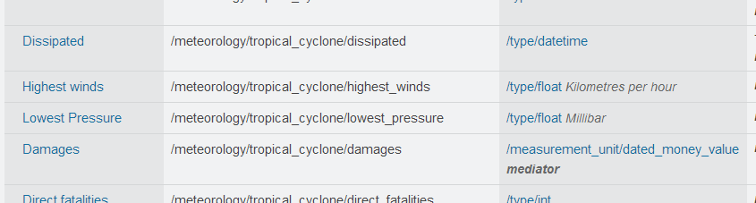
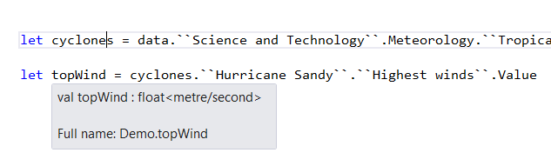
Providing Units of Measure
If the metadata contains units…
via F#’s Units of Measure
…then these can be projected into the programming language.

Slide 55
Theme #5 Schema Change

Slide 56
Hard problem, some progress…
Many, many data sources are surprisingly stable
Support “invalidation signals” from providers at design-time
Erasure makes compiled code much less fragile
Some data sources support “snapshot dates” (c.f. Datomic, Freebase)
Data scripting has low exposure

Slide 57
Theme #6 Type Systems Encounter Reality

Slide 58
This is different…
“The idea of integrating internet-scale information services directly into the program's variable and type space is probably the most innovative programming language idea I’ve heard of in a decade” (Jim Cordy, Queens U)
Perhaps, perhaps not…
But if something so simple is perceived as so different, we need think why
(What follows is somewhat whimsical)

Slide 59
This is different…
We like to see PL systems as logical systems
Traditional logical systems exclude interaction with reality
This is a powerful and simplifying assumption
It is also fundamentally wrong for modern applied programming languages
This goes back to the roots of classical logic
Blame Bertrand Russell and Alonzo Church

Slide 60


Γ $⊢ e$ : τ
Lots of work here
Lots of work here
The exclusion of reality!
The neglected child
Γ₀ = 0

Slide 61
Meditations on Γ₀
Γ₀ is the ever-growing ocean of digital reality around us
Γ₀ is big. Really big.
Γ₀ defies imagination for its enormity
Γ₀ is other. It doesn’t speak your language
Γ₀ is being organized at an incredible rate
Γ₀ needs us. We’re hitting the limit with e and tau
Γ₀ is surprisingly “human”

Slide 62
Meditations on Γ₀
Γ₀ is full of uncertainty and probabilities.
You are mutually recursive with Γ₀. You are part of it.
Γ₀ has many open doors, many locked doors
Γ₀ has many, many parts that do not get on particularly well.
Γ₀ is so real you want to touch it, explore it
Don’t look too long.
It’s like staring at infinity

Slide 63
The computational life of types If type definitions represent abstractions of reality, then they evolve temporally Strong relationship with variational type checking (“checked #if”)

Slide 64
Related Work
Ur
Gosu
Scala Type Macros
Scheme/Lisp Macros
Idris
Template Haskell
…

Slide 65
Some Research Questions
Can incorporate schema change policies?
Can temporal and probabilistic metadata be useful for typing or tooling?
Can we provide all the data in the enterprise (e.g. SAP or Reuters)?
Temporal types? Probabilistic types? Reactive types?
Can we verify provider components?
Can richer constraints, security, privacy and provenance annotations be provided?
Can we provided types be mutually recursive?

Slide 66
Tomorrow Digging into provider implementation

Slide 67
Tomorrow Digging into the compiler interface

Slide 68
Thank you!! Questions?

